Slide 1
Small RNAs and how to analyze them using sequencing
Jakub Orzechowski Westholm
Long-term bioinformatics support, Science For Life Laboratory Stockholm
Department of Biophysics and Biochemistry, Stockholm University

Slide 2
Small RNAs
Small RNAs are species of short non-coding RNAs, typically <100 nucleotides
micro RNAs (miRNAs)
short interfering RNAs (siRNAs)
piwi associated RNAs (piRNAs)
clustered regularly interspaced short palindromic repeats (CRISPRs)
mirtrons, cis-natRNAs, TSS-miRNAs, enhancer RNAs and other strange things

Slide 3
1. Background on regulatory small RNAs

Slide 4
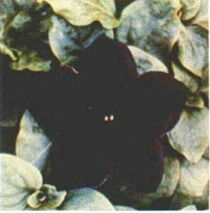

1991: RNA can repress gene expression
wt
Overexpression of pigment gene CHS
“ The mechanism responsible for the reversible co-suppression of homologous genes in trans is unclear ..”
(Napoli et al. Plant Cell, 1991.)

Slide 5
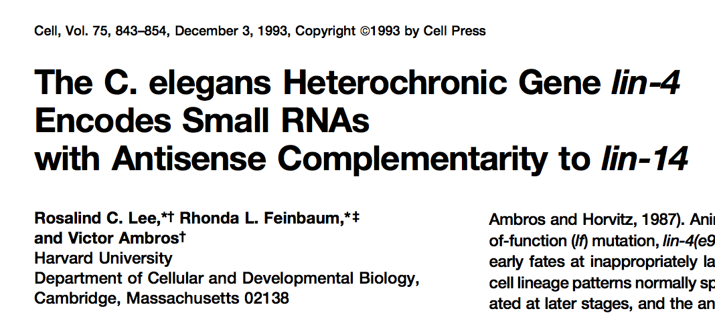
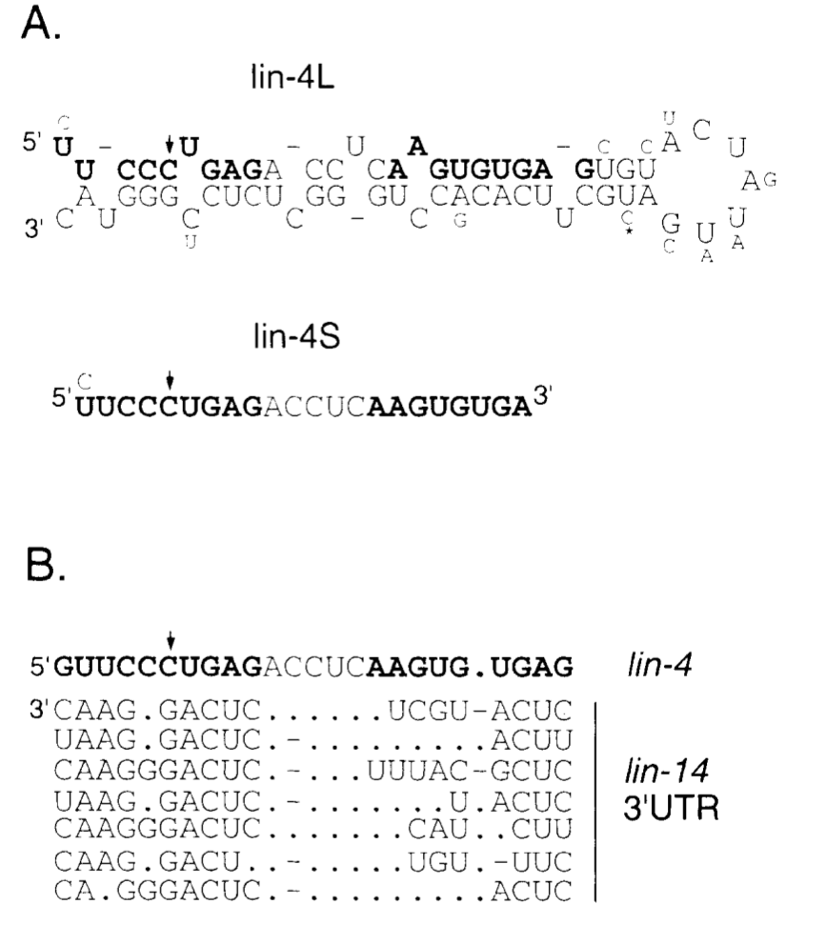
1993: The first microRNA is discovered in the worm genome
A mutation in the lin-4 locus disrupts worm development.
The lin-4 locus encodes a non-coding RNA that forms a hairpin structure and produces two small transcripts, 61 and 22 nt.
Part of this RNA is complementary to the 3’UTR of a developmental gene, lin-14

Slide 6
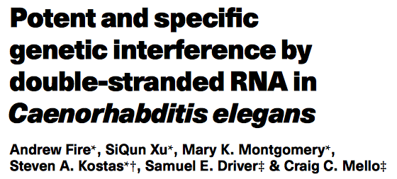
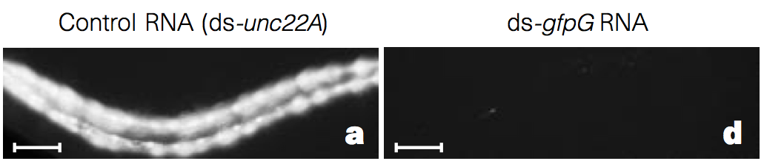
1998: double stranded RNA can efficiently repress gene expression
“To our surprise, we found that double-stranded RNA was substantially more effective at producing interference than was either strand individually.”
RNAi = RNA interference

Slide 7
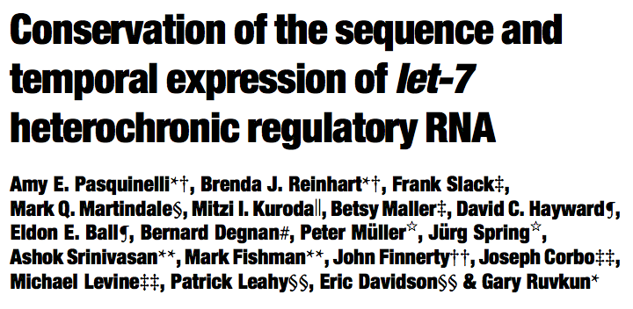
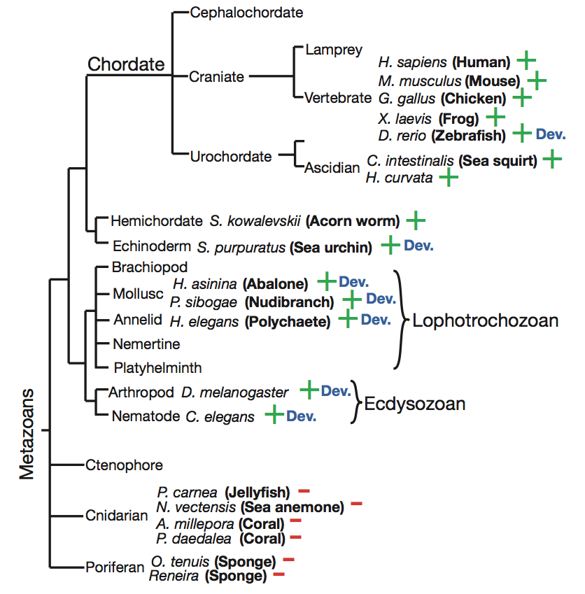
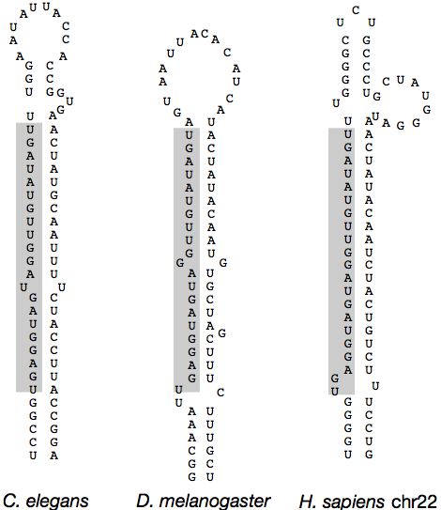
2000: a second, conserved, microRNA is found

Slide 8

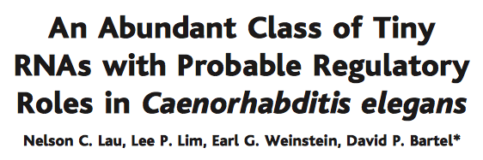
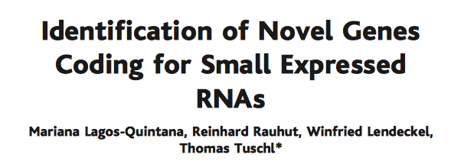
2001: many microRNAs are found in various animals
Using:
RNA structure prediction
Comparative genomics
(low throughput) sequencing

Slide 9
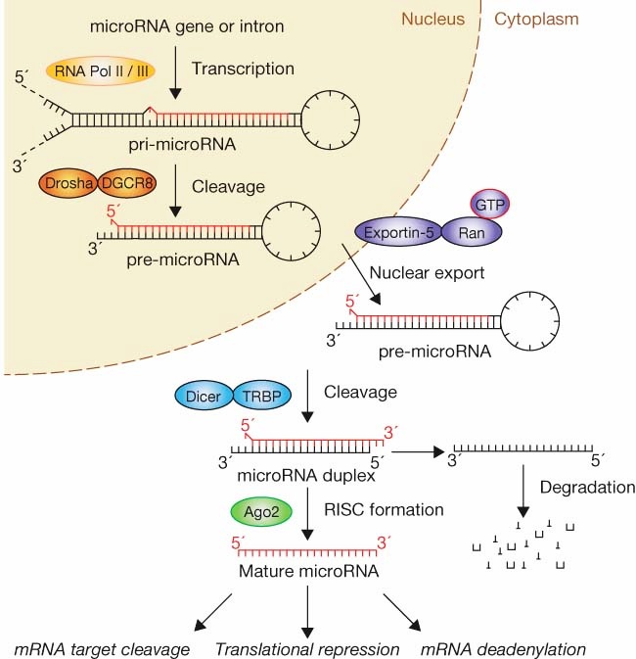
microRNA biogenesis
Many enzymes etc. are involved: Drosha, Exp5, Dicer, ....
The end result is a ~22nt RNA loaded into an Argonaute complex.
The microRNA directs Argonaute to target genes, through base pairing with the 3’UTR (pos 2-8). This causes repression.
(Winter et. Nature Cell Biol, 2009)

Slide 10
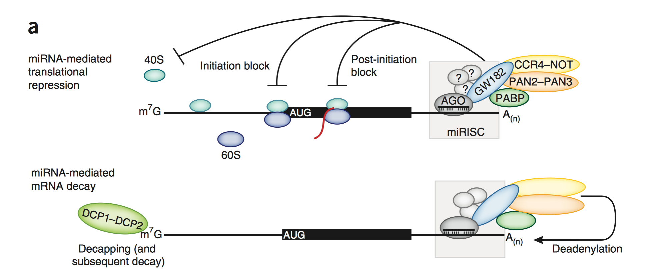
Target repression by microRNAs
(This is in animals. microRNAs in plants work differently.)
(Fabian, NSMB, 2012)

Slide 11
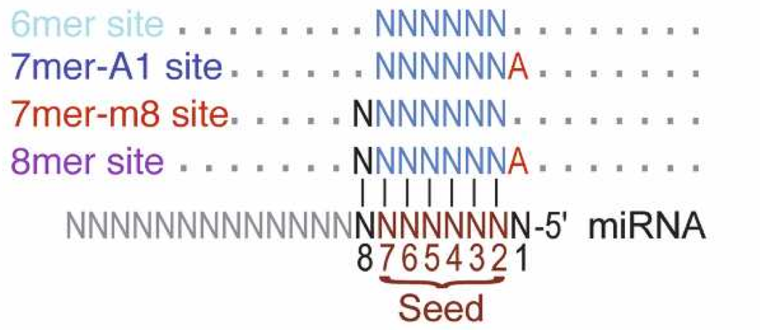
How do microRNAs find their targets?
In animals, microRNAs find their targets through pairing between the microRNA seed region (nucleotides 2-8) and the target transcript
(Friedman et al. Genome Research, 2009)
Such short matches are common → a microRNA can have hundreds of targets.
It is estimated that over half of all genes are targeted by microRNAs.

Slide 12
MicroRNA target prediction
Besides seed pairing, other features are used in the target predictions:
Conservation (conserved target sites are more likely to be functional)
mRNA structure (it’s hard for a microRNA to interact with a highly structured target mRNA)
Sequences around the target site (AU rich sequences around targets?)
Many programs exist for microRNA target prediction (targetScan, mirSVR, PicTar, ..)
These are not perfect. Target prediction is hard, and a lot of details about the mechanism are still not known.

Slide 13
MicroRNAs in animal genomes
There are typically hundreds or thousands microRNAs in animal genomes:
Fly: ~300 microRNA loci
Mouse: ~1200 microRNA loci
Human: ~1900 microRNA loci
A single locus can produce multiple microRNA forms (called isomirs).
In a given tissue, their expression can range over 6 orders of magnitude (a few to a few million reads)

Slide 14
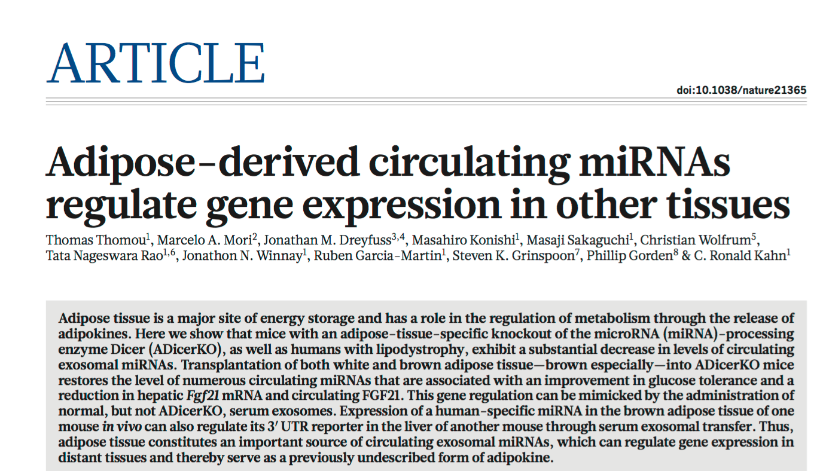
microRNAs regulate many biological processes and are involved in disease
Development
Stress response
Cancer
Cardiovascular disease
Inflammatory disease
Autoimmune disease

Slide 15
2. Small RNA sequencing

Slide 16
Sequencing
Small RNA sequencing is similar to mRNA sequencing, but:
There is no poly-A selection. Instead RNA fragments are size selected (typically less than 35 nucleotides, to avoid contamination by ribosomal RNA).
Low complexity libraries → more sequencing problems
FastQC results will look strange:
Length
Nucleotide content
Sequence duplication

Slide 17
Pre-processing of small RNA data I
Since we are sequencing short RNA fragments, adaptor sequences end up in the reads too.
Many programs available to remove adaptor sequences (cutadapt, fastx_clipper, Btrim..)
We only want to keep the reads that had adaptors in them.
GTTTCTGCATTTTCGTATGCCGTCTTCTGCTTGAA
GTGGGTAGAACTTTGATTAATTCGTATGCCGTCTT
GTTTGTAAATTCTGATCGTATGCCGTCTTCTGCTT
GAATATATATAGATATATACATACATACTTATCGT
GCTGACTTAGCTTGAAGCATAAATGGTCGTATGCC
GACGATCTAGACGGTTTTCGCAGAATTCTGTTTAT
Adapter missing

Slide 18
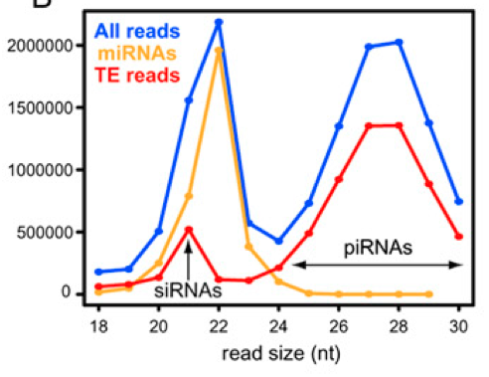
Pre-processing of small RNA data II
microRNAs are expected to be 20-25 nt.
Short reads are probably not microRNAs, and are hard to map uniquely
Long reads are probably not microRNAs
GTTTCTGCATTTTCGTATGCCGTCTTCTGCTTGAA
GTGGGTAGAACTTTGATTAATTCGTATGCCGTCTT
GTTTGTAAATTCTGATCGTATGCCGTCTTCTGCTT
GCTGACTTAGCTTGAAGCATAAATGGTCGTATGCC
To short
(Lau et al. Genome Research, 2010)

Slide 19
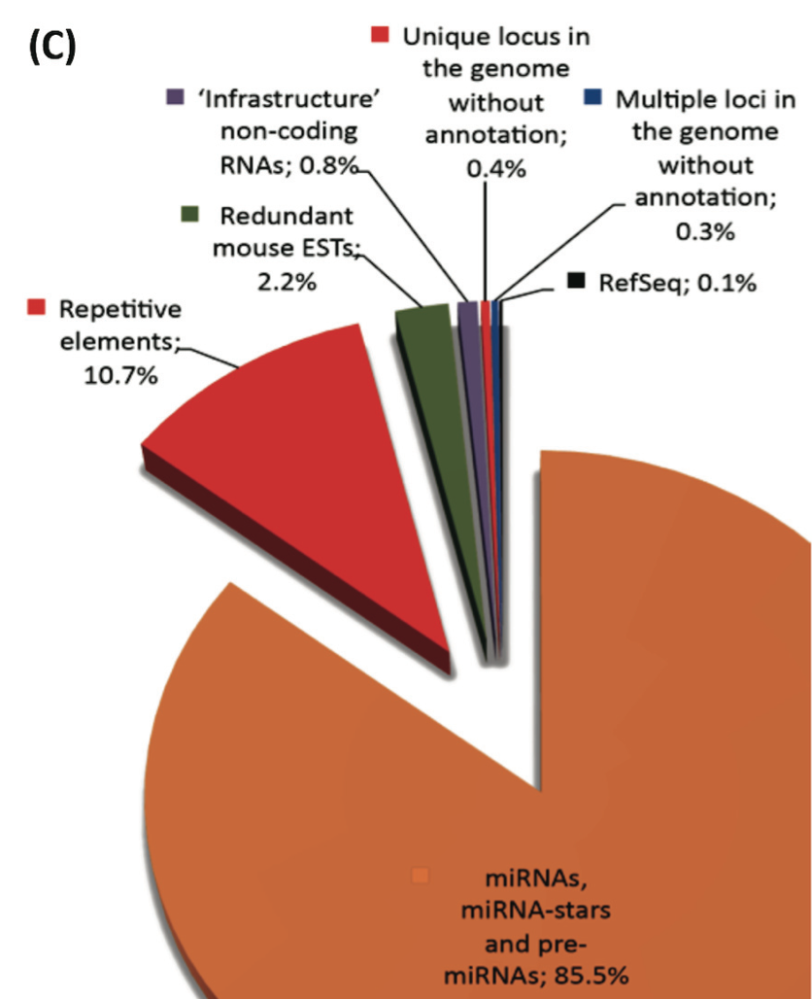
Pre-processing of small RNA data III
Another useful QC step is to check which loci the reads map to:
(Ling, BMC Genomics, 2011)

Slide 20
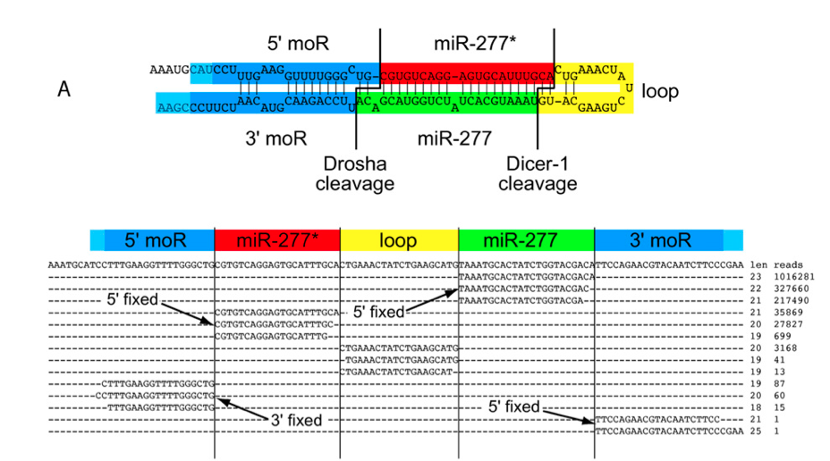
Example of reads mapping to a microRNA locus
(Berezikov et al. Genome Research, 2011.)
Notes:
Fixed 5’ ends of miRs
Variable 3’ ends – trimming, tailing

Slide 21
Quantifying small RNA expression I
A
B
C
CGTGTCAGGAGTGCATTTGCA
TAAATGCACTATCTGGTACGACA
Count all reads mapping to a locus? - The simplest option, usually good for profiling.
Count reads from each hairpin arm? - Useful if we want to correlate this with expression of target genes, or do more careful profiling.
Only count reads that exactly match the mature microRNA? - Not a good idea, because we will miss variants

Slide 22
Quantifying small RNA expression II
microRNAs from the same family can be very similar (or identical)
How treat this:
Keep in mind that some microRNAs are hard to separate.
If a read maps to several N loci, count 1/N read at each locus.
…

Slide 23
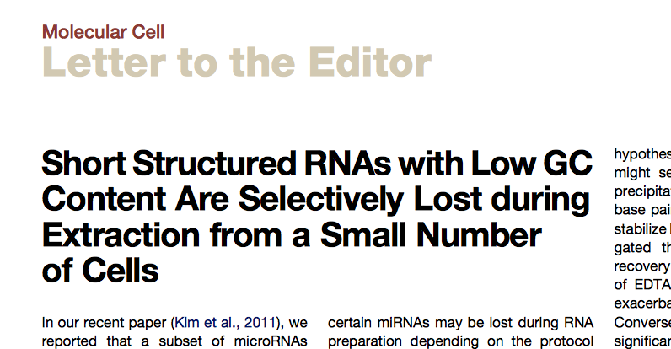
Error sources
Different chemistries and protocols can have different effects on expression measurements.
We only get a few different sequences from each microRNA, so any biases can have big effects. (In normal RNA-seq each gene generates many different reads, so this is not a big problem)
Normalization doesn’t fix these problems → it’s hard to compare data from different platforms etc.
The amount of starting material can influence the results:

Slide 24
Normalizing small RNA expression levels I
Only a few loci, and huge differences in expression levels → a few miRNAs can account for the majority of all reads, and skew expression levels of all microRNAs.
“True” expression levels
Nr reads sequenced
mir1
mir2
mir1
mir2
mir3
mir1
mir2
mir1
mir2
mir3
Condition A
Condition B
Condition A
Condition B
Since many reads are used to sequence mir3 in condition B, fewer are available for mir1 and mir2.
Normalization needs to deal with this situation. Simply scaling read counts by the total number mapped reads will not solve this problem.
(Spike-in are always useful for normalization.)

Slide 25
Normalizing small RNA expression levels II
Different methods for normalization
TMM (“trimmed mean of M-values”) normalization (Robinson et al. 2010, Genome Biology, McCormick et al. 2011, Silence)
In short, TMM normalization works like this:
Compute log ratios of all microRNA (“M-values”)
Remove (“trim”) the highest and the lowest log-ratios, and the highest and lowest expressed microRNAs.
Use a mean of the remaining log-ratios to compute the scaling factors
The underlying assumption is that most microRNAs have similar expression levels in the different samples, and should have similar expression levels after normalization.

Slide 26
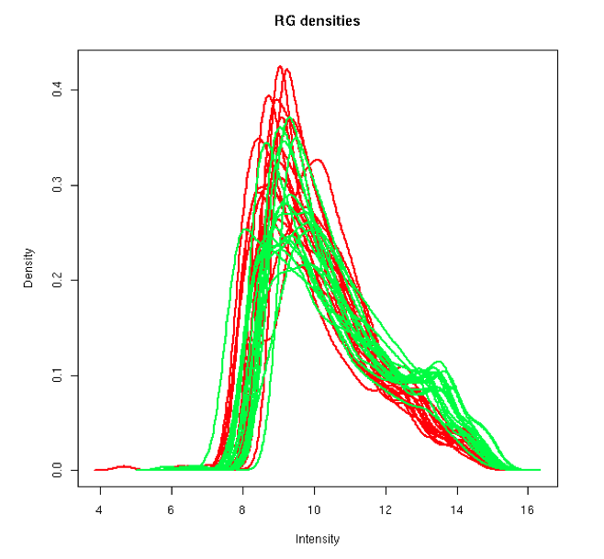
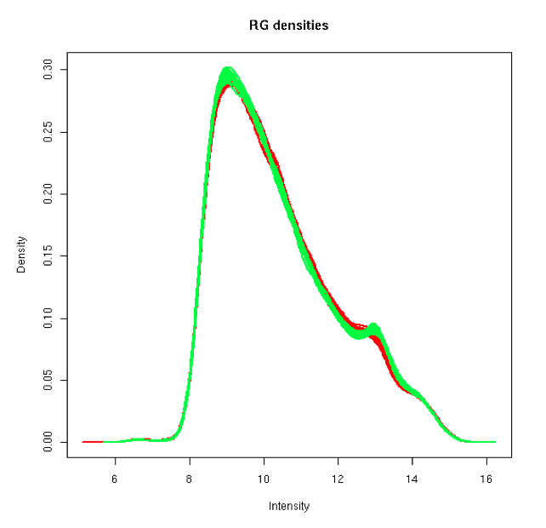
Normalizing small RNA expression levels III
Quantile normalization (Garmire et al. RNA, 2012)
The underlying assumption is that the overall expression distribution is the same in all samples.
Many other methods exist, developed for RNA-seq or microarrays.
No consensus about which method to use → always good to try a few different methods.
Before normalization
After normalization
Nr loci
Nr loci
Expression level
Expression level

Slide 27
Differential expression
After the expression levels have been properly normalized, methods for RNA-seq differential expression can be used.
ANOVA, t-tests
DeSeq, edgeR, voom, limma, etc..
No consensus on which method is best.
Keep in mind: Since microRNA quantification is less reliable than normal RNA-seq:
More replicates are needed.
More validation experiments are required (Northern blots, in-situ hybridization, etc.).
Use caution when interpreting results!

Slide 28
3. What can we learn from microRNA expression analysis?

Slide 29
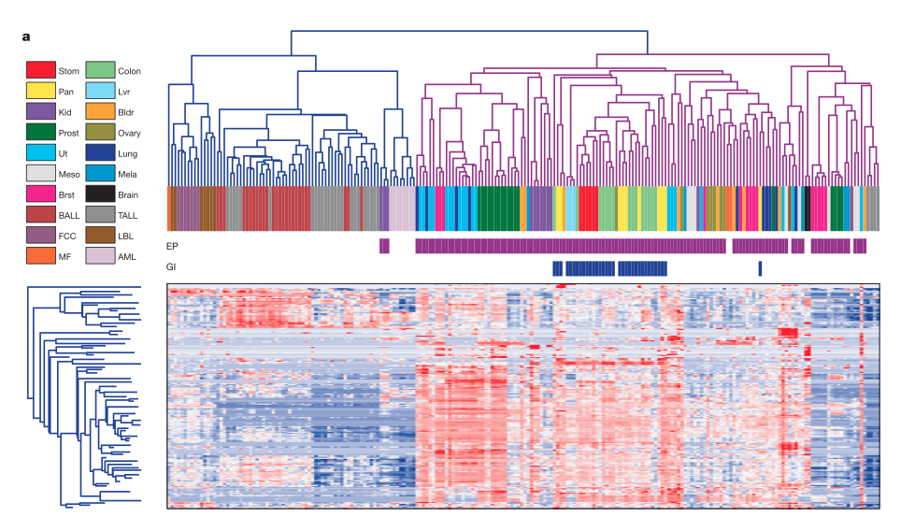
MicroRNA expression profiles classify human cancers
microRNA expression profiles cluster according to cancer type.
(Lu et al. Nature 2005)
Notes:
This is not using sequencing, but the analysis of expression levels is similar

Slide 30
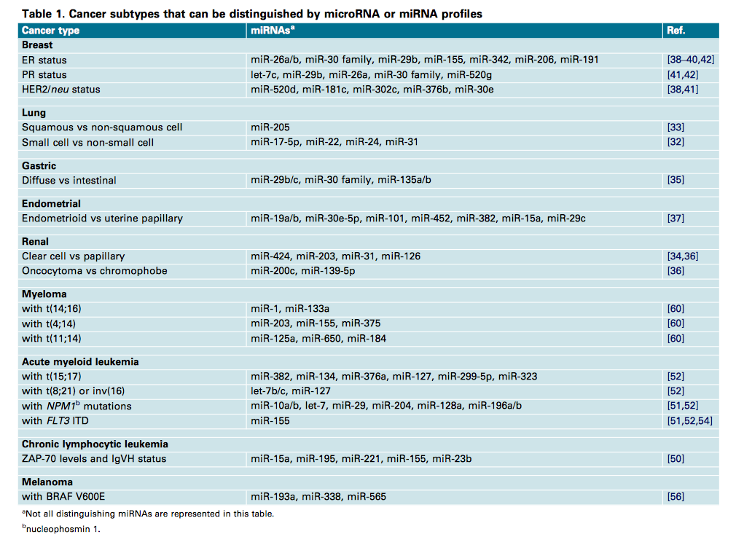
microRNA profiles can be used to distinguish cancer subtypes
(Chan et al. Trends in Molecular Medicine, 2010)

Slide 31
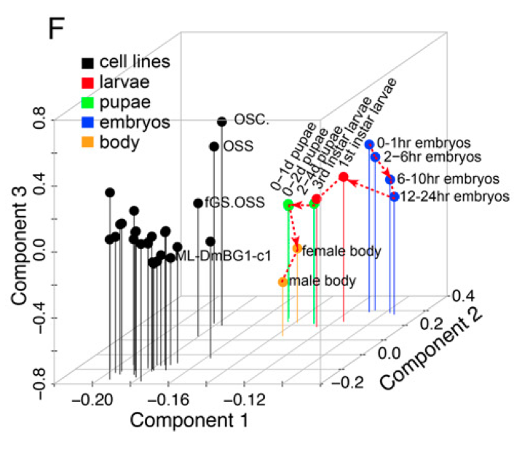
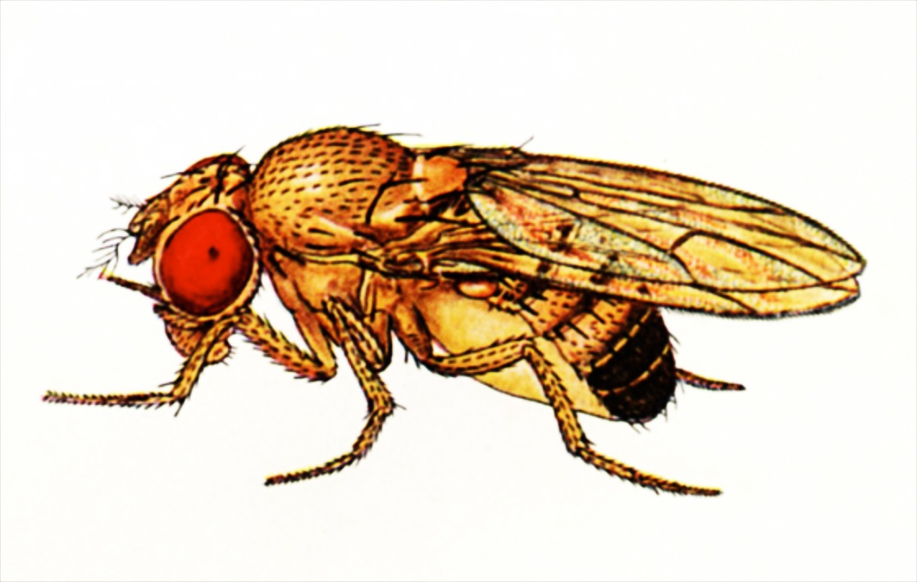
microRNA profiles in cell lines vs tissues
PCA plot showing that microRNA profiles in most cell lines are more similar to each other than to normal tissues.
(Wen et al. Genome Research 2014)

Slide 32
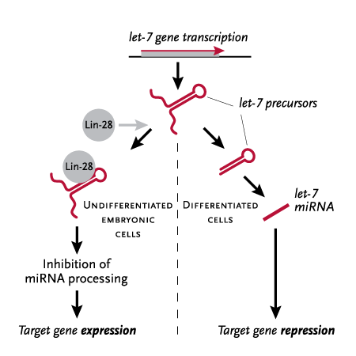
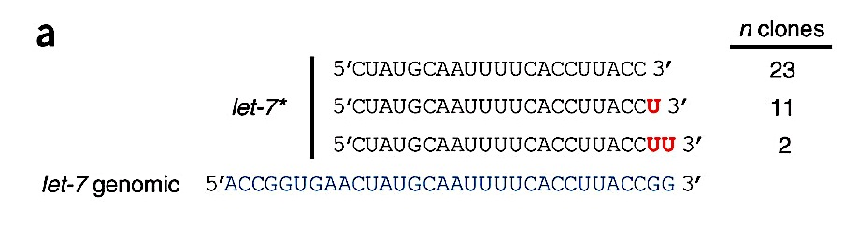
microRNA regulation in cancer and development
The microRNA let-7 is involved in regulating developmental timing, and is a tumor suppressor.
let-7 is repressed by the protein lin-28.
This repression is post-transcriptional, and is associated with uridylation at the 3’ end of let-7.
Using sequencing, such uridylation can be observed for many microRNAs.
Lin-28
(It’s also possible to see microRNA editing.)
(Lehrbach et al. NSMB, 2009)

Slide 33
Discovering new small RNA loci
microRNAs have very specific patterns, when it comes to
Read size and mapping
RNA structure
Conservation
This makes it possible to find microRNAs using small RNA sequencing data.

Slide 34
mirDeep(2)
The most used program for finding new microRNAs. Takes as input:
A genome sequence
Small RNA sequencing data
A set of loci to exclude (optional)
The basic idea is:
Look at sequence data to find a (large) set of possible loci.
Look at RNA folding and read mapping patterns to give a score to each candidate
Nr reads from both arms
Fixed read ends
Free energy, base pairing in the hairpin structure, ..

Slide 35
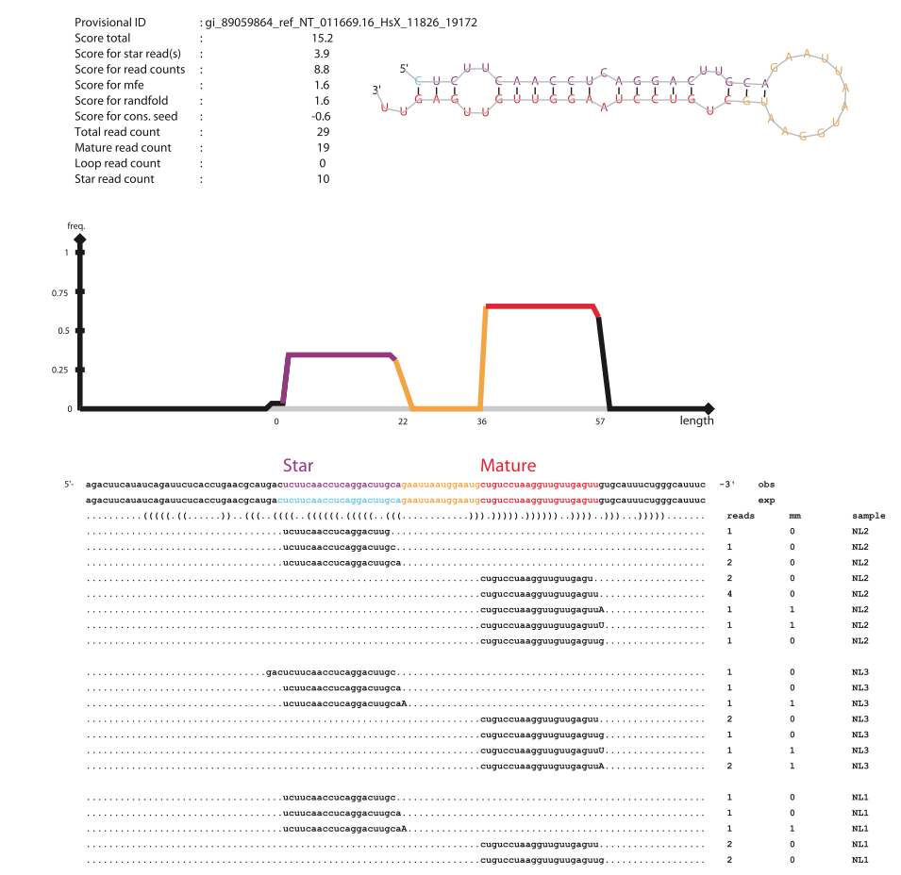
Output is a list of microRNA candidates, with scores, and a plot for each candidate:
mirDeep2 is installed on UPPMAX.
There are also other programs, e.g. shortStack (Axtell, RNA, 2013) which also finds other small RNAs.
(Friedlä̈nder et. al. Nucleic Acids Reseach, 2011)

Slide 36
Other strange small RNAs that show up in sequencing data
mirtrons
piRNAs
tRNA fragments
hp-RNAs
TSS-microRNAs
cis-natRNAs
Some of these are functional
Some are by products of RNA processing, and can be informative (e.g. microRNA loop sequences).
Some are probably just “noise”.

Slide 37
The end

